Slide 1
Digital Portfolio
STUDENT NAME : Thrisha S
REGISTER NO AND NMID : 16FC5FD58C5D31C8B5D4B35478A096B1
DEPARTMENT : BSc Computer Science
COLLEGE : Vel Tech Ranga Sanku Arts College / University of Madras

Slide 2
PROJECT TITLE
Digital Portfolio
Name: Kishore D
BSc Computer Science, 2nd Year
Key Skills: Java, Web Development, Creative Design
Projects: Web apps, Wallpapers, Logos
Contact: [Email] | [LinkedIn] | [GitHub]

Slide 3
AGENDA
Problem Statement
Project Overview
End Users
Tools and Technologies
Portfolio design and Layout
Features and Functionality
Results and Screenshots
Conclusion
Github Link

Slide 4

PROBLEM STATEMENT
In today's digital era, traditional resumes are not enough to effectively showcase skills and projects.
Many students and professionals lack a structured online presence to highlight their work and achievements.
A digital portfolio offers an interactive and accessible solution to present skills, experiences, and accomplishments in a modern, engaging way.

Slide 5

PROJECT OVERVIEW
Brief summary: This project is a digital portfolio to professionally present my background, skills, and creative work.
Contains key sections: About Me, Projects, Skills, and Contact for easy navigation.
Main idea: Showcase personal achievements, highlight technical expertise, and display completed projects in an organized manner.

Slide 6
WHO ARE THE END USERS?
Students: Showcase academic projects, assignments, and build resumes for further studies.
Job Seekers: Share skills, experience, and portfolio with recruiters and employers.
Freelancers: Present work samples and completed projects to attract potential clients.
Professionals: Highlight career achievements, expertise, and ongoing development.

Slide 7

TOOLS AND TECHNIQUES
HTML: Builds the main structure of all portfolio pages and sections.
CSS: Styles the portfolio with colors, layouts, and makes it responsive for all device sizes.
JavaScript: Adds interactivity-navigation menu, animations, and form validation.
Code Editor: Developed using VS Code for efficient coding.
Hosting: Published online using GitHub Pages for easy sharing and access.

Slide 8
POTFOLIO DESIGN AND LAYOUT
Organized sections:
Home/About Me, Projects, Skills, Contact.
Consistent color scheme and clean typography throughout the portfolio.
Easy navigation bar for smooth movement between sections.
Visual elements like icons and images for better engagement.
Fully responsive layout optimized for both mobile and desktop devices.

Slide 9
FEATURES AND FUNCTIONALITY
Navigation bar with smooth scrolling for easy access to all sections.
Project showcase including images and detailed descriptions for each project.
Interactive elements such as hover effects and animations to enhance user engagement.
Contact form with validation to ensure correct and complete user input.
Responsive design that works seamlessly on desktop, tablet, and mobile devices.

Slide 10
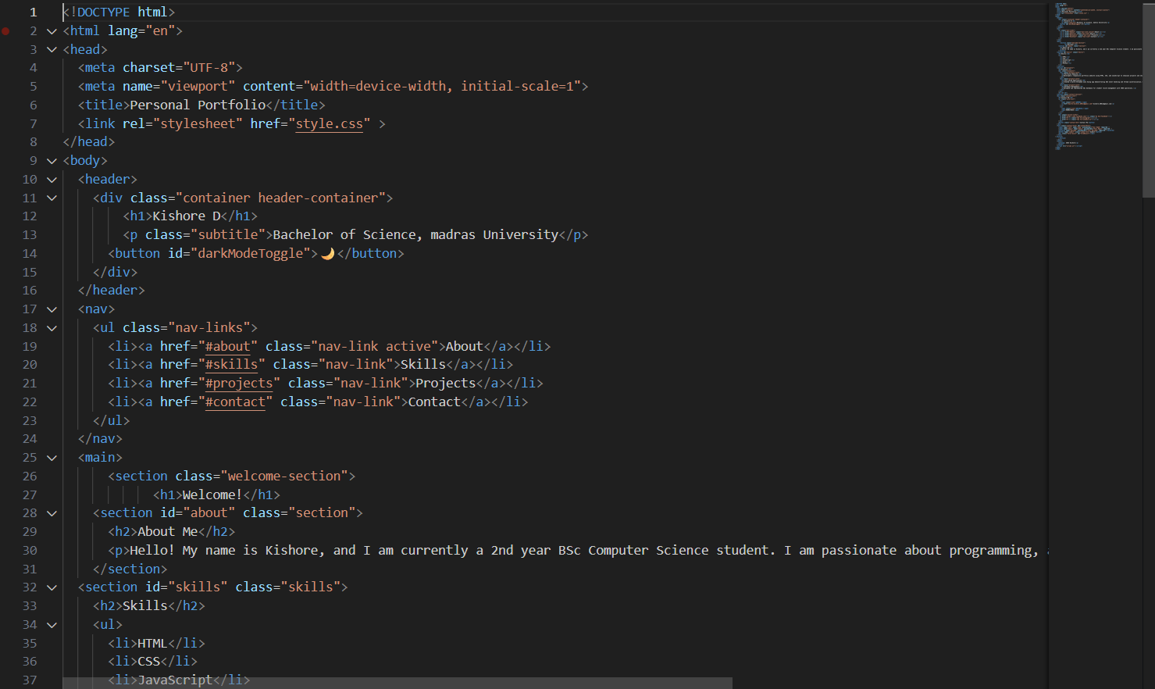
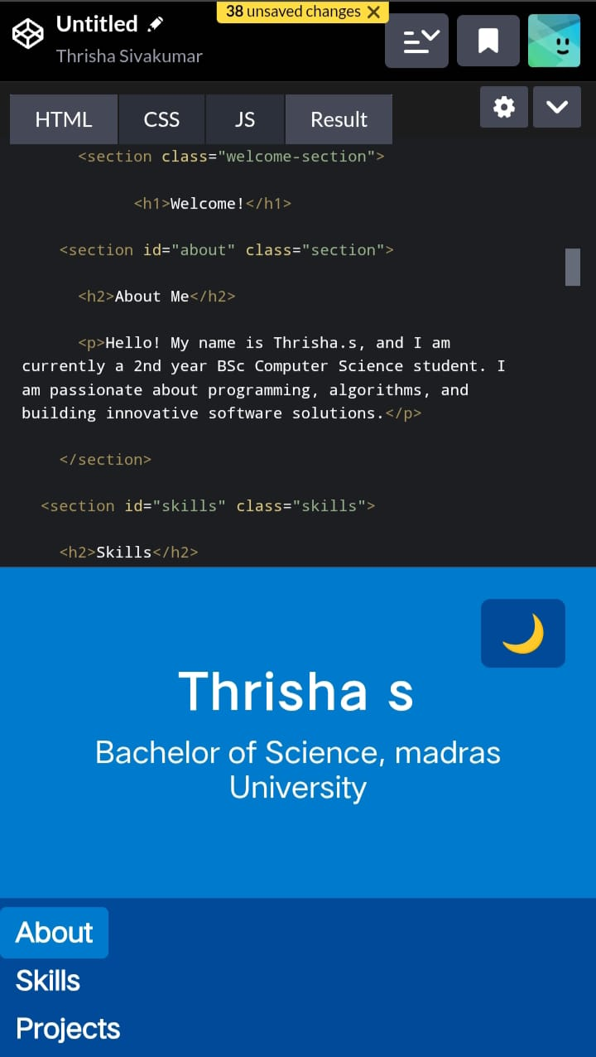

RESULTS AND SCREENSHOTS
HTML :

Slide 11
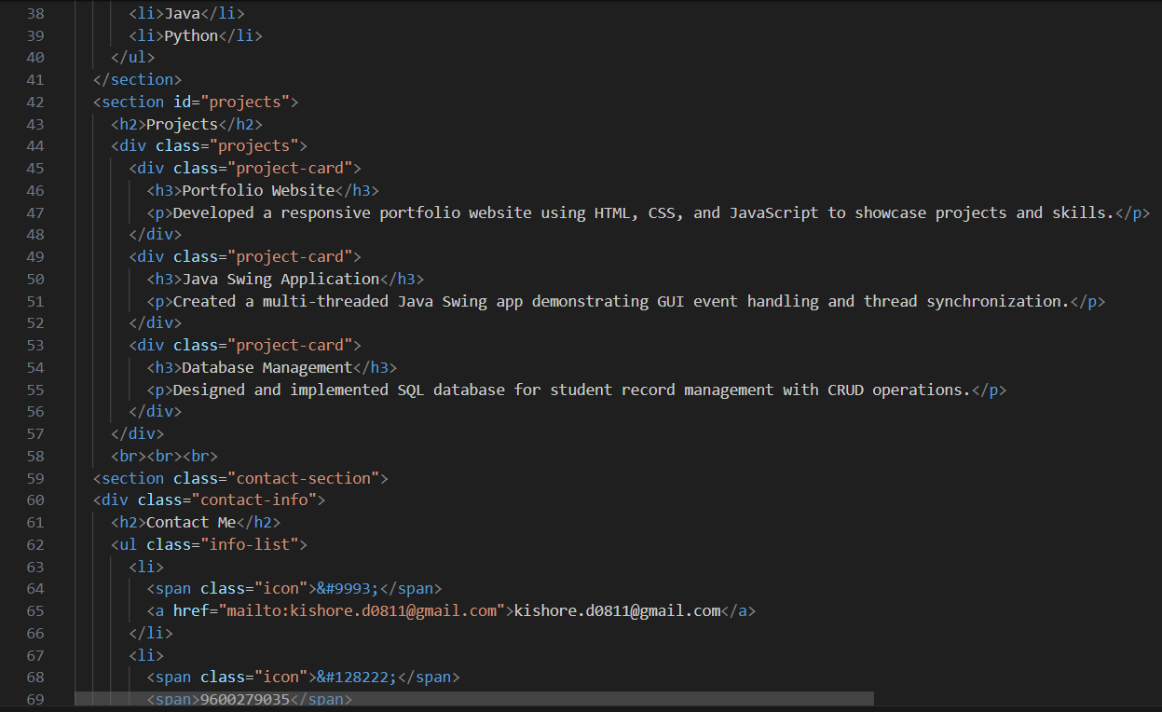
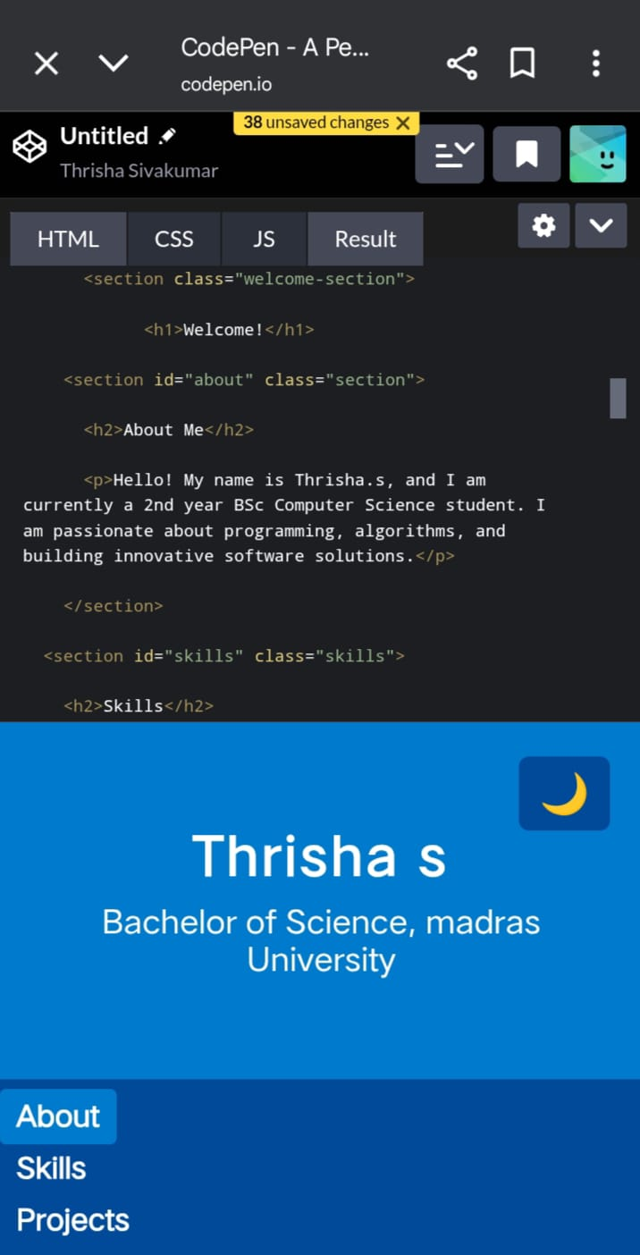
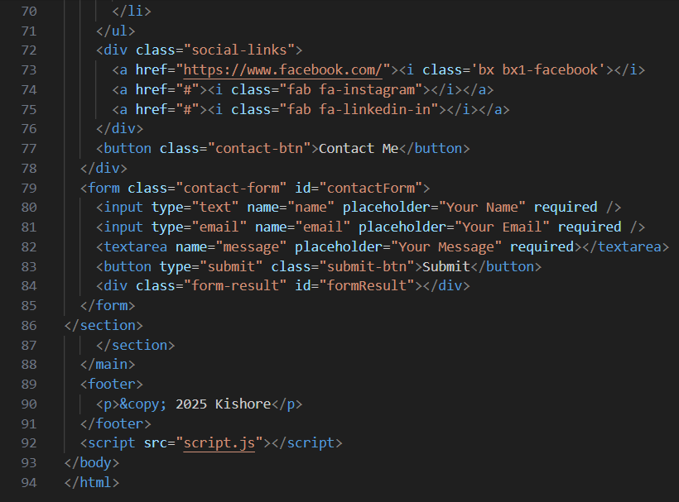
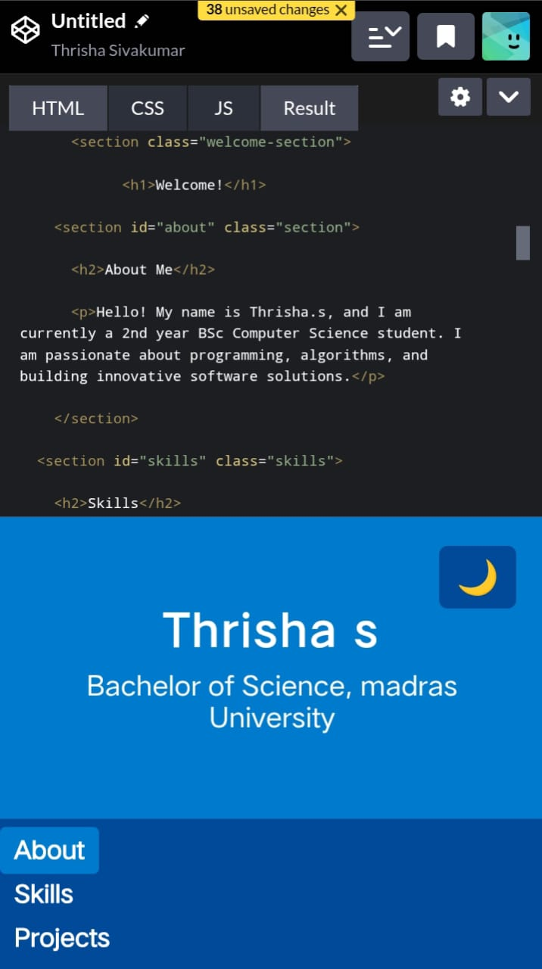

Slide 12
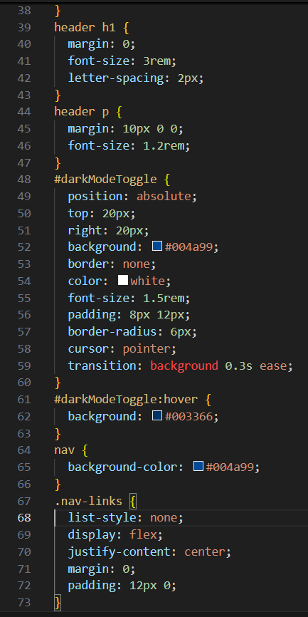
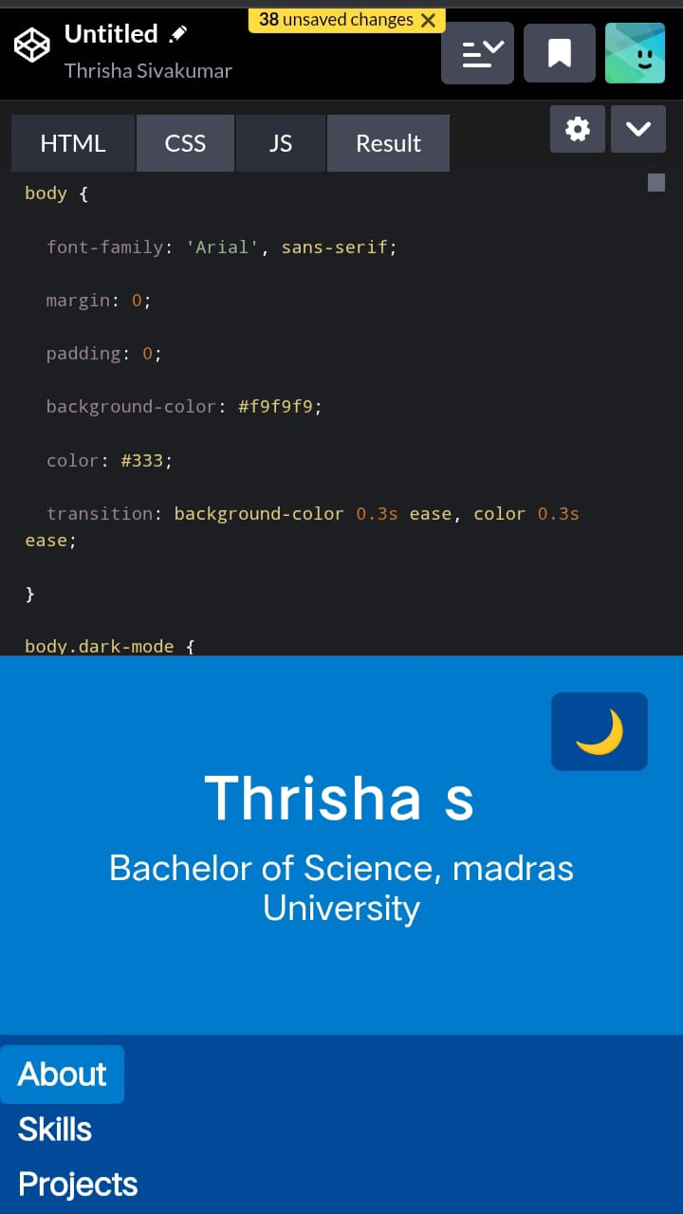
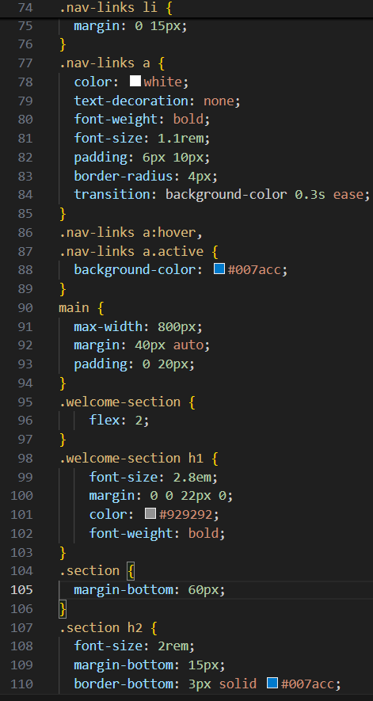
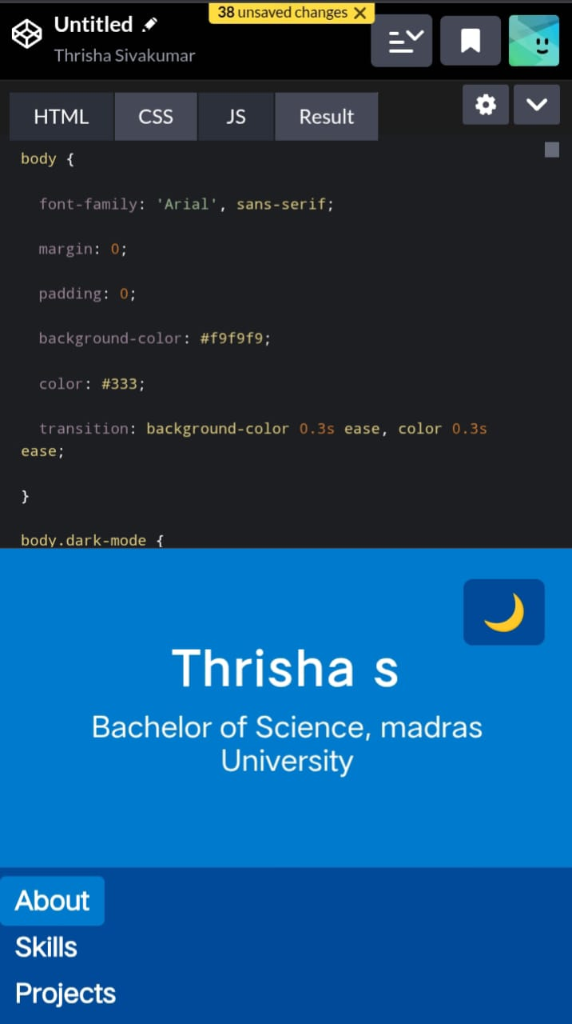

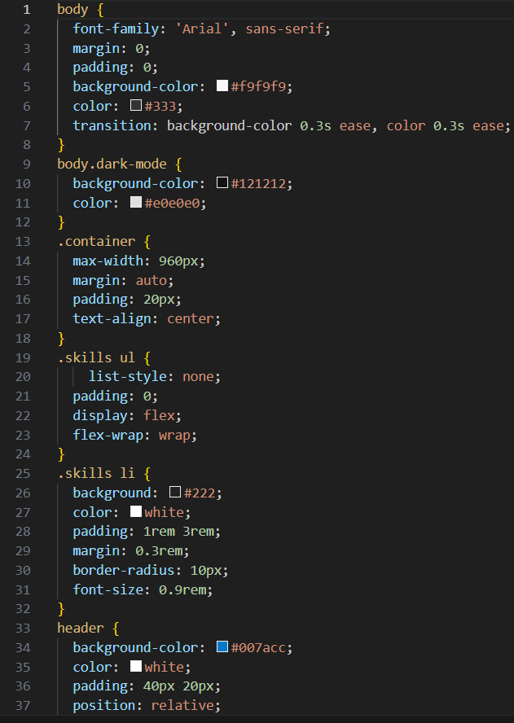
CSS :

Slide 13

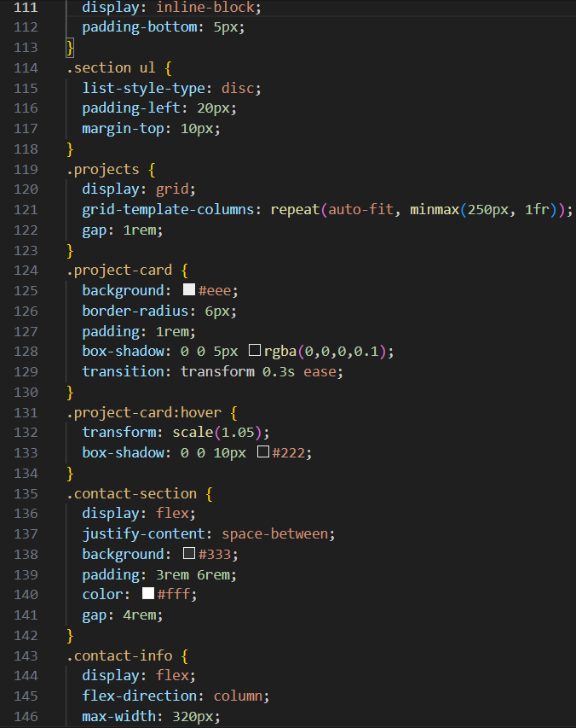
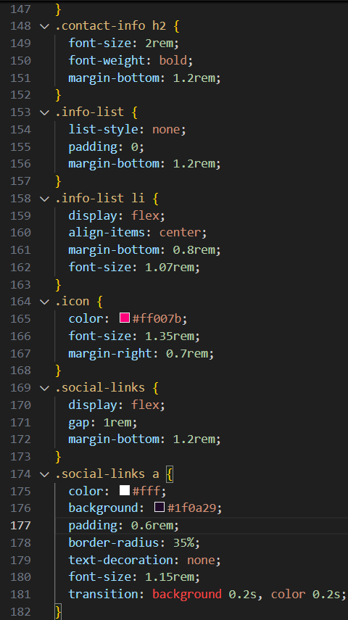
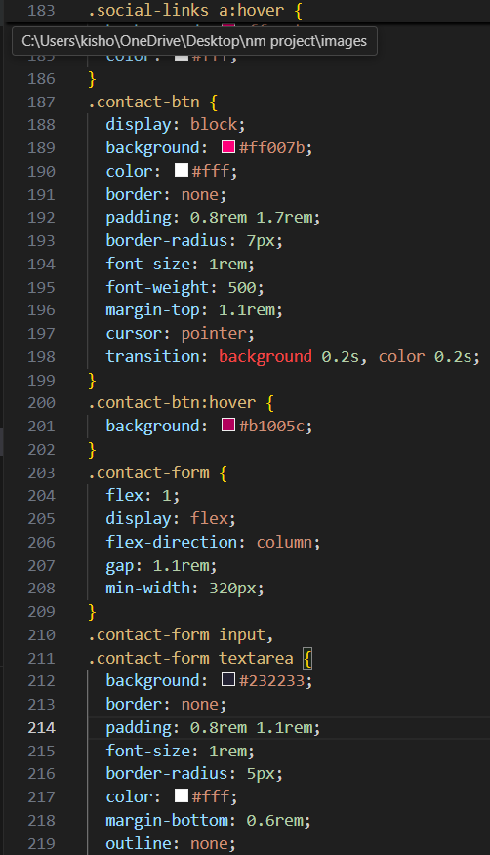

Slide 14
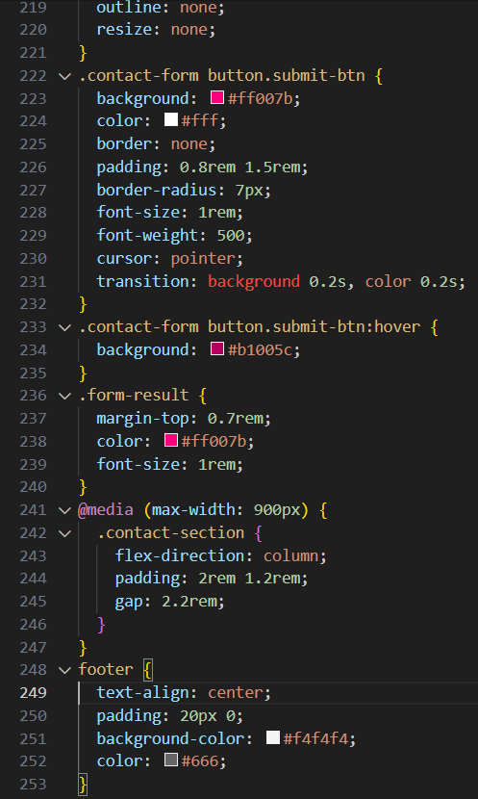

Slide 15
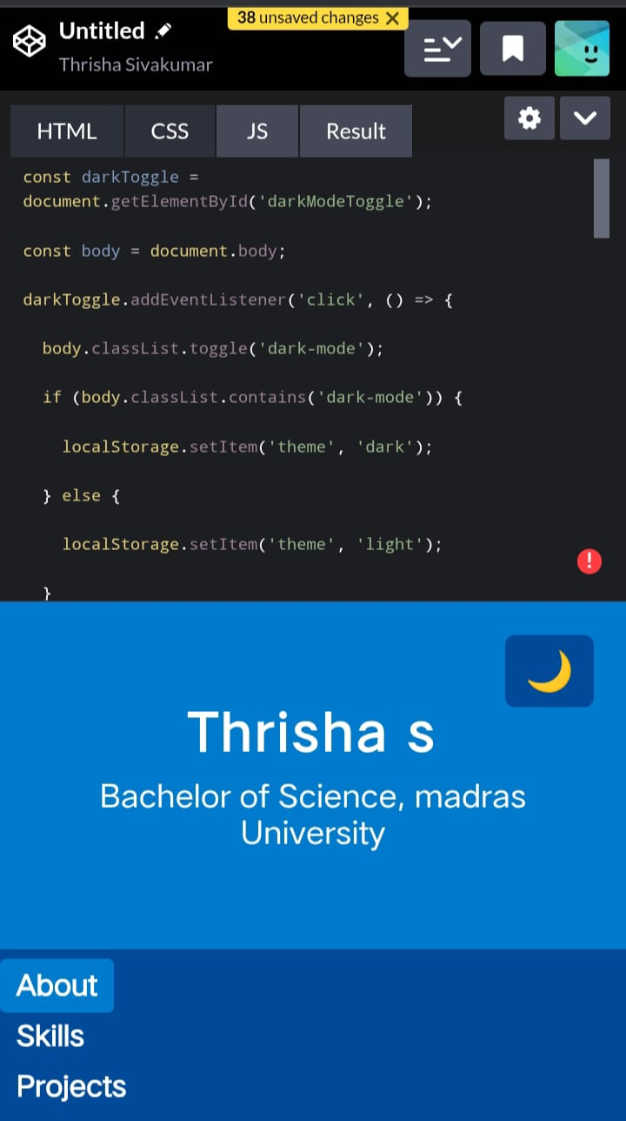
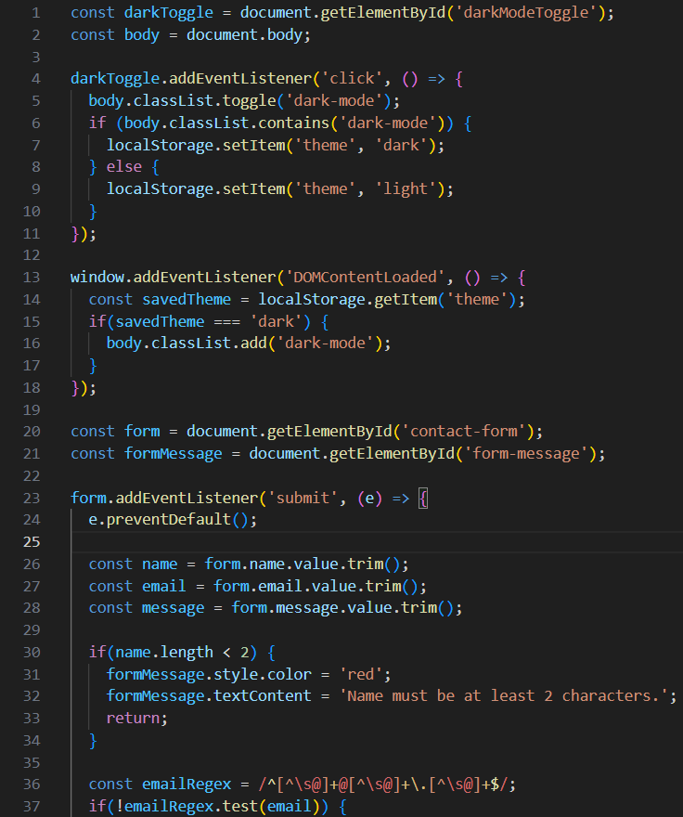
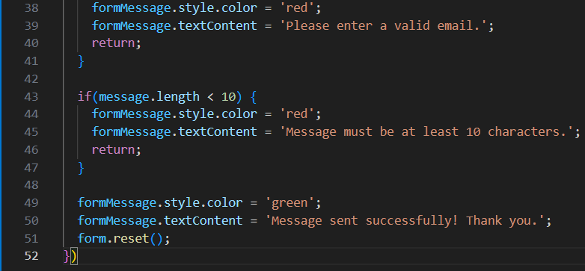
JavaScript :

Slide 16


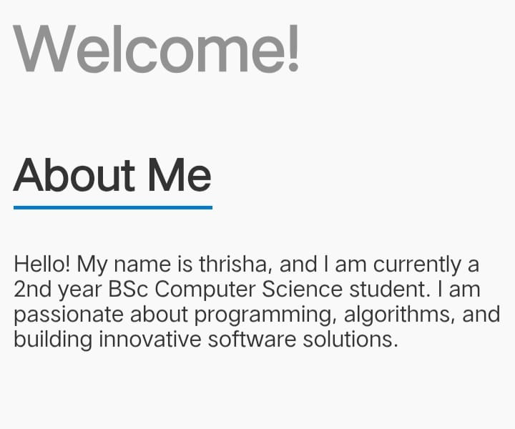

Navigation :
About Me :

Slide 17
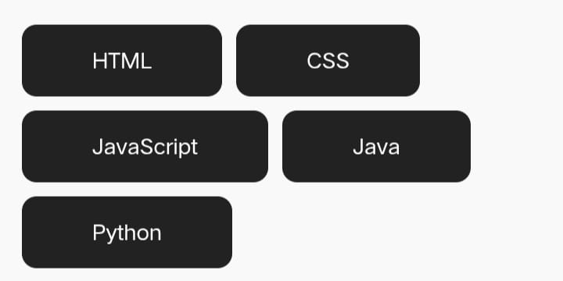

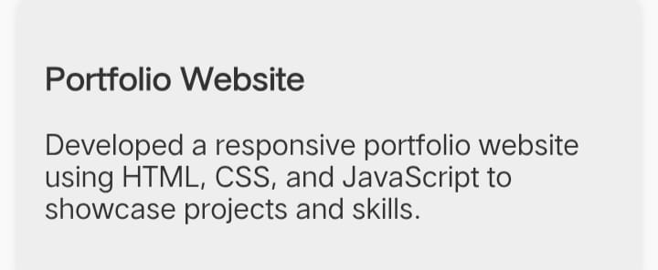
Skills :
Projects :

Slide 18
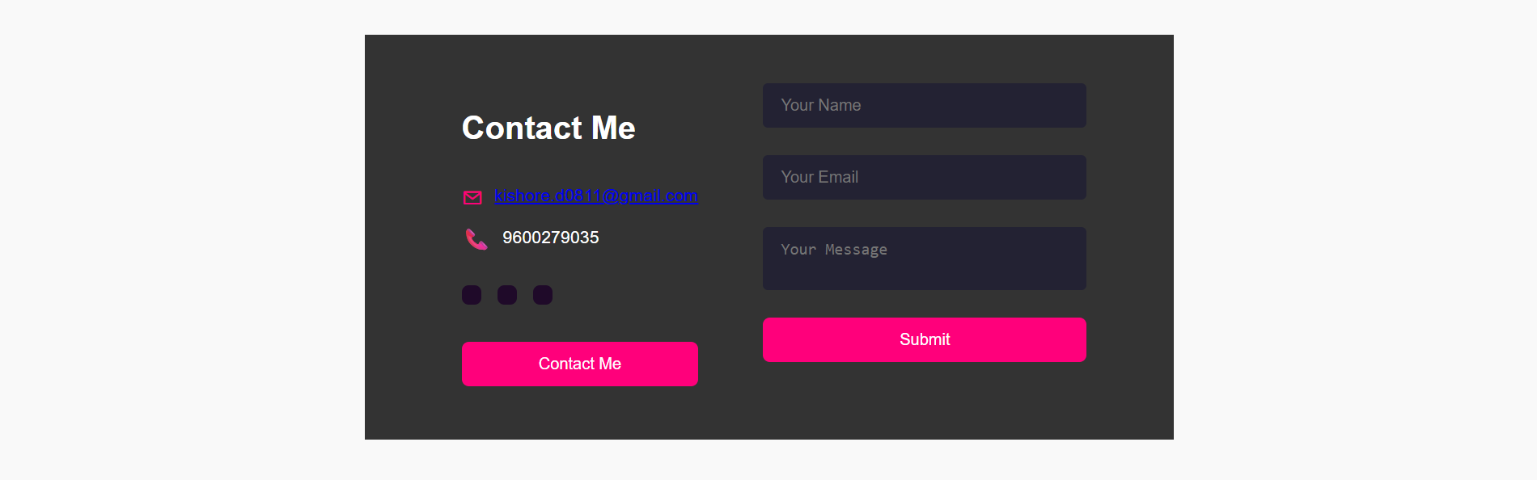
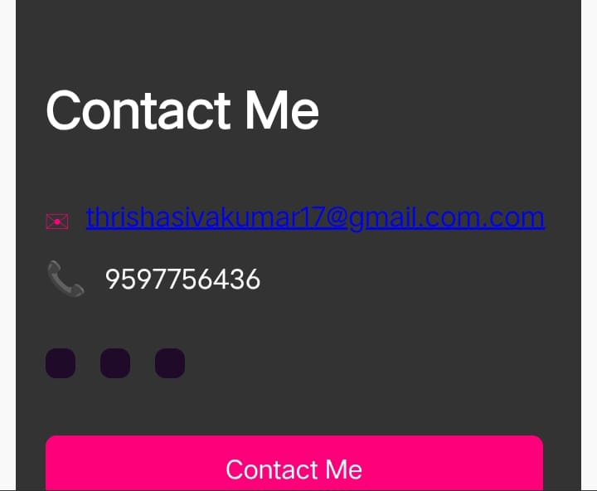
Contact Me :
Footer :

Slide 19
CONCLUSION
Highlights of Your Project:
Integrates both technical (coding, web development) and creative (design, wallpapers, logos) projects in a single portfolio.
Features a user-friendly, visually attractive layout for easy navigation and engagement.
Provides interactive elements like clickable project links and external profiles for deeper exploration.

Slide 20
Final Summary:
Demonstrates a holistic approach to personal branding and self-presentation in the digital age.
Offers a comprehensive record of skills, achievements, and creative growth beyond traditional resumes.
Acts as a dynamic platform adaptable for academic, professional, and creative opportunities.

Slide 21
Benefits to Society:
Encourages students and professionals to showcase their real skills and passion authentically.
Fosters inspiration and knowledge sharing among peers, educators, and professionals.
Helps bridge the gap between talent and opportunity, supporting career growth and collaboration.

Slide 22
THANK YOU ❤️

